Slide 1
Carry Look Ahead Adder

Slide 2
.
Carry Look Ahead Adder
We Look Ahead For Carry Before Adder Execution.

Slide 3
Why We Need CLA?

Slide 4
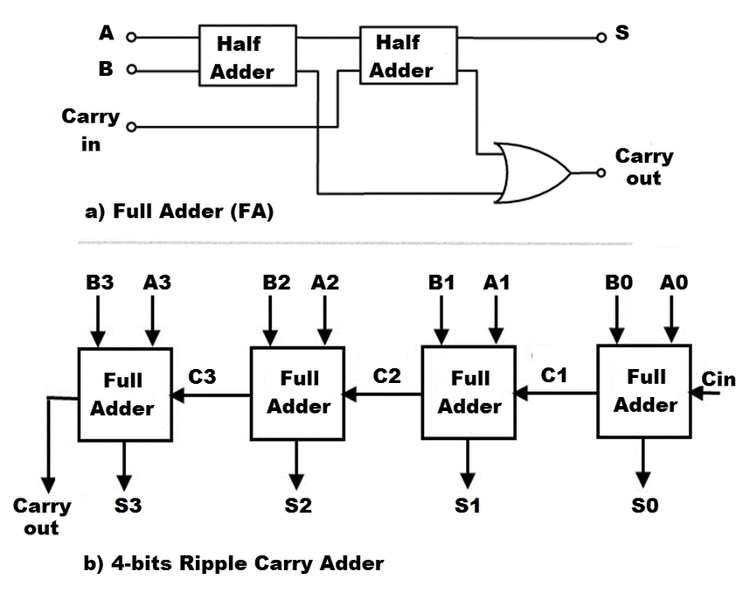
Drawbacks Of RCA

Slide 5
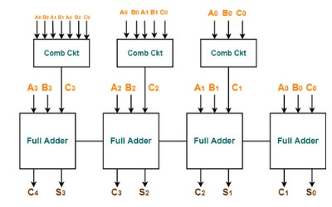
Carry Look Ahead Adder

Slide 6
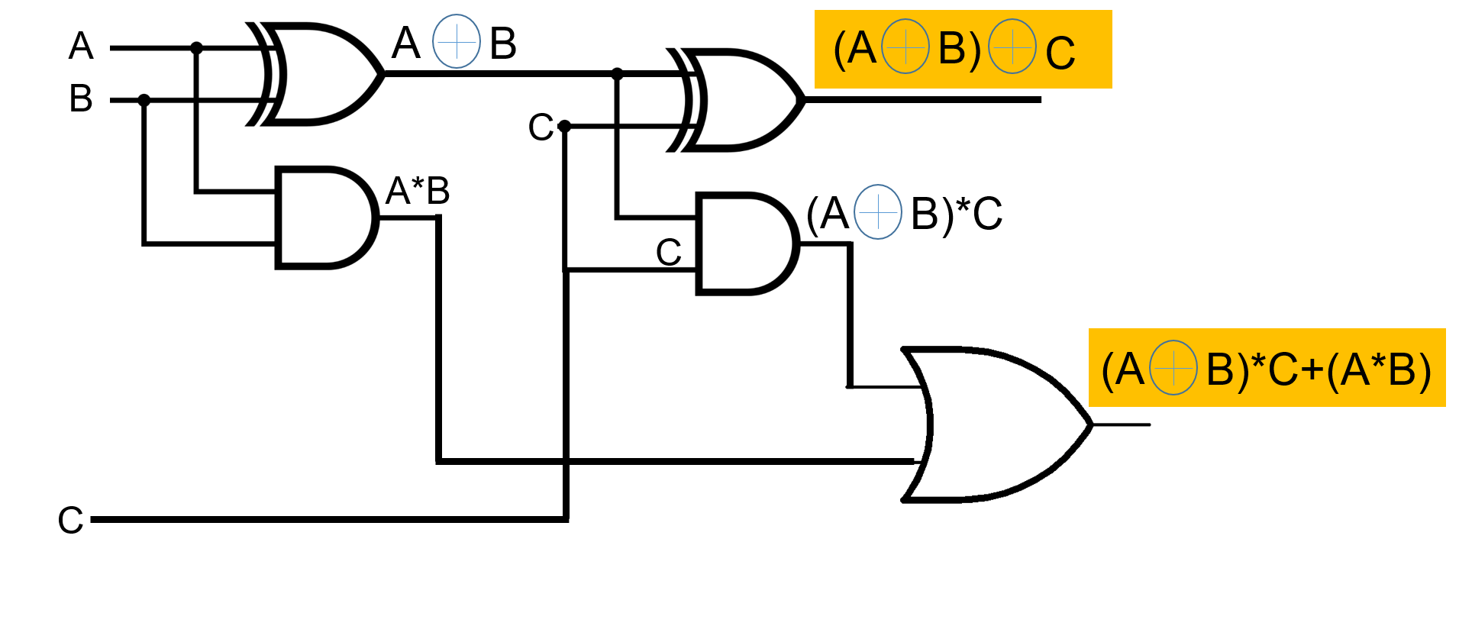
Full Adder

Slide 7
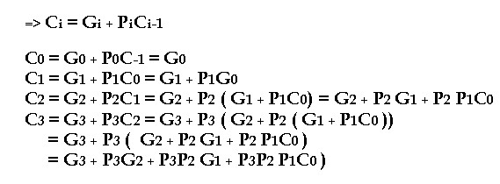
Combinational Circuit

Slide 8
ThankYou
YOU CAN GET THIS SLIDES FROM GITHUB:
GITHUB/KRISHANKANHAYA/CLAA

